Slide 1
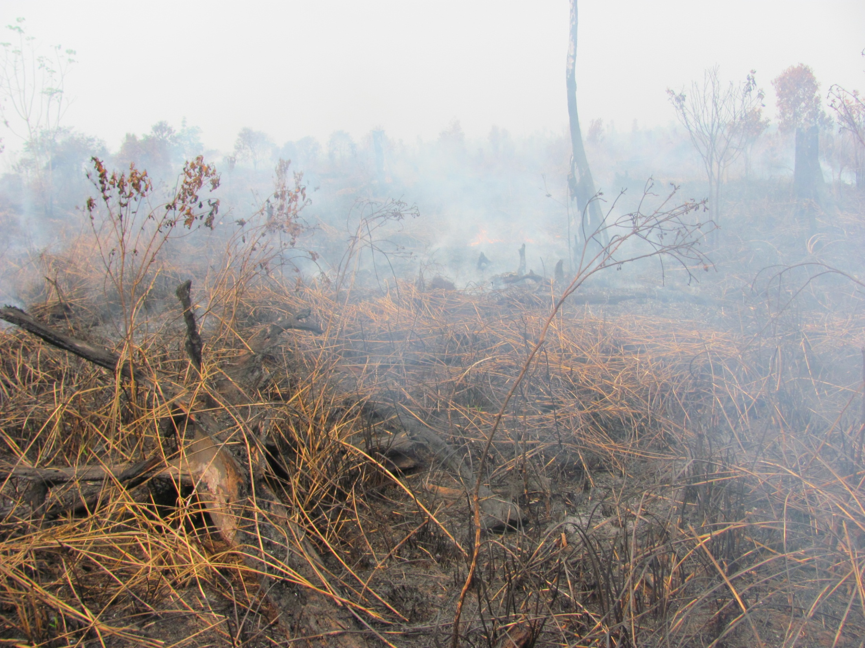
Toward improved peat-fire related MRV capacity in Indonesia
Mark A. Cochrane
Geospatial Sciences Center of Excellence
South Dakota State University
NASA CMS Science Team Meeting & Applications Workshop
Bethesda, MD – November 12-14, 2014

Slide 2
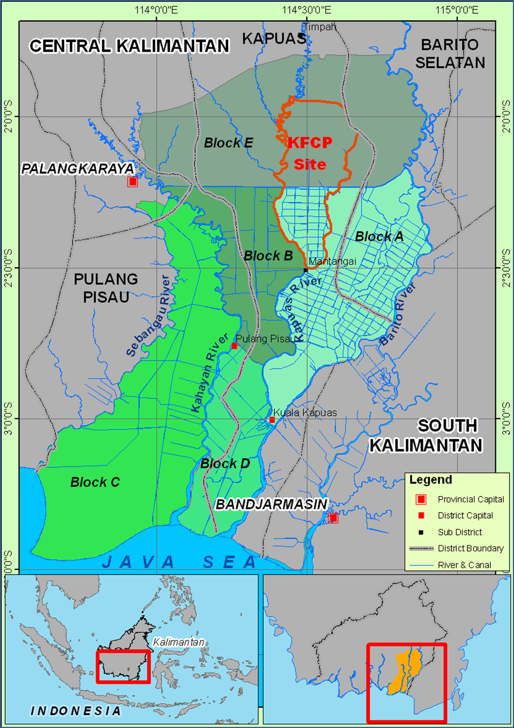
Why Here?
Indonesia is the 3rd largest emitter of CO₂
Much of the emitted carbon comes from deep organic soils underlying former peat swamp forests
The ex-Mega Rice Project (MRP) drained 1 million hectares of peatlands in Central Kalimantan.
The 120,000 ha Kalimantan Forest Climate Partnership (KFCP) site is a large REDD+ project within the ex-MRP.
The Indonesian Carbon Accounting System (INCAS) currently lacks capability to track emissions from peatlands and assess ongoing mitigation activities.

Slide 3
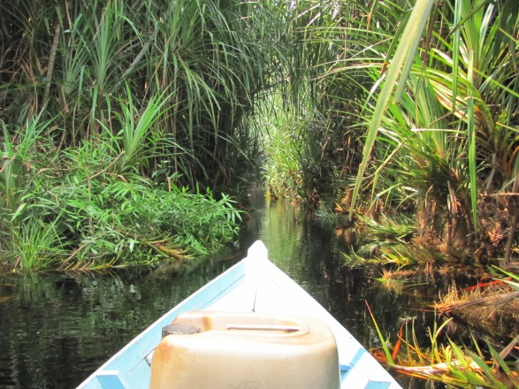
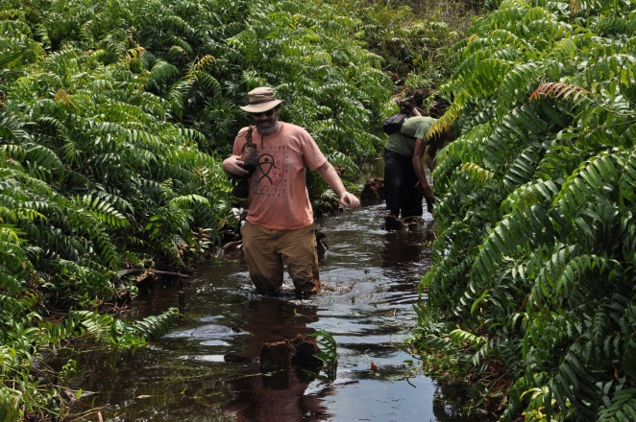
Getting there is half the battle…
Access is via rivers and canals.
Easiest in the wet season but the main work is in the dry season.
Data collection is accomplished in ‘expeditions’.

Slide 4
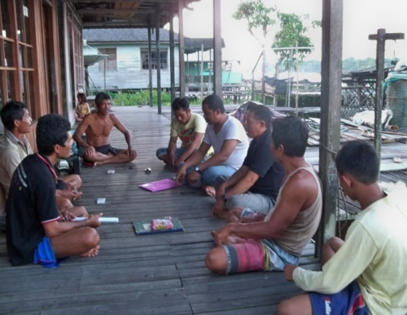
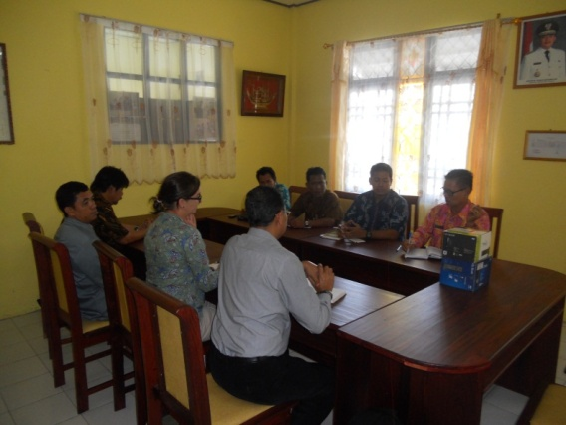
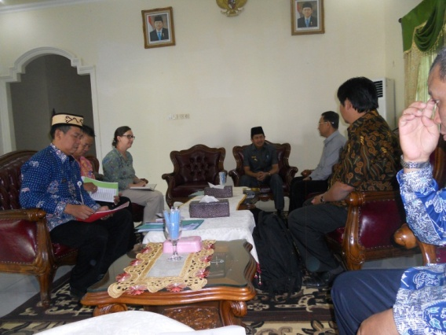
The project requires substantial outreach with stakeholders
We have been working very closely with:
Local communities and governments to ensure they understand and are in agreement with the activities taking place within their land areas.
District and provincial governments to ensure support of their sub-national carbon accounting needs

Slide 5
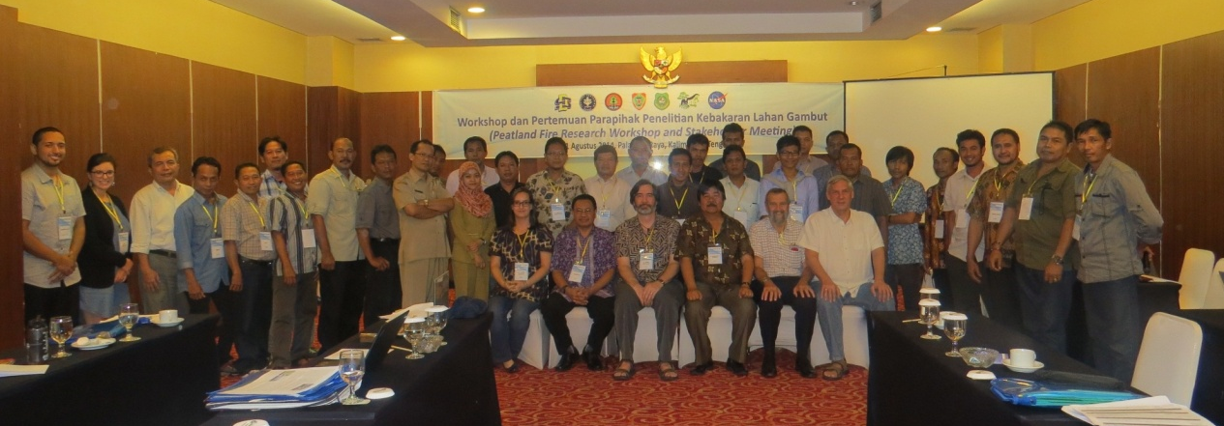
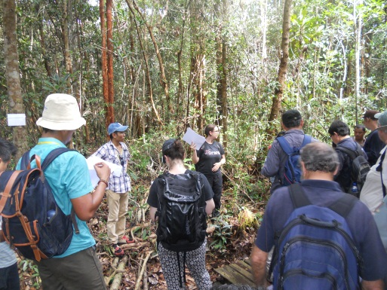
Socialisation workshop
International | GGGI, CPI
National | INCAS
Provincial | Dept’s for Land Planning, Environment, Forestry, Conservation, Secretary to the Governor
District
REDD+ | Sekber REDD+, UNORCHID
US | IFACS, SDSU, Rutgers, UCLA, Applied Geosolutions
Academic | IPB, UNPAR, BPK Banjarbaru, Tuanan
We hosted an international kick-off three-day workshop and training with over 50 participants from over 26 institutions

Slide 6
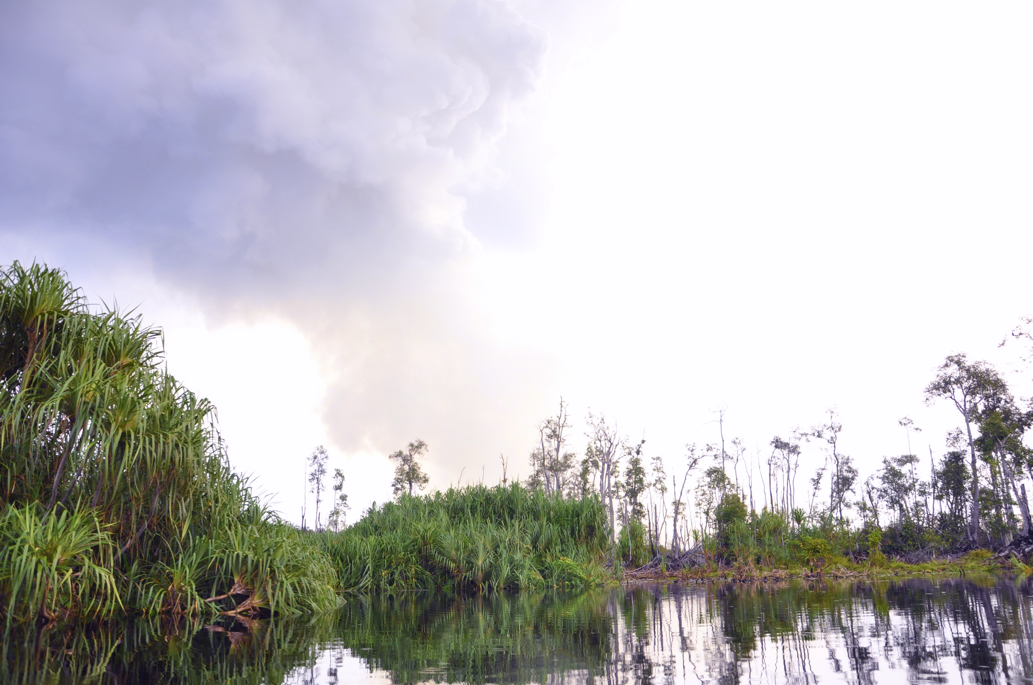
Major issues for creating a functional and credible MRV system
Detecting fires
Determining what can burn
Mapping burned area
Quantifying relevant emission factors
Estimating the volume and mass of consumed biomass

Slide 7
MODIS gives a relative idea of the inter-annual numbers of fire events

Slide 8
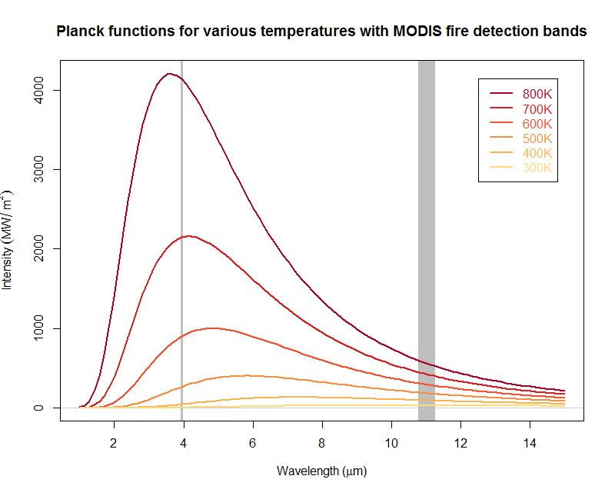
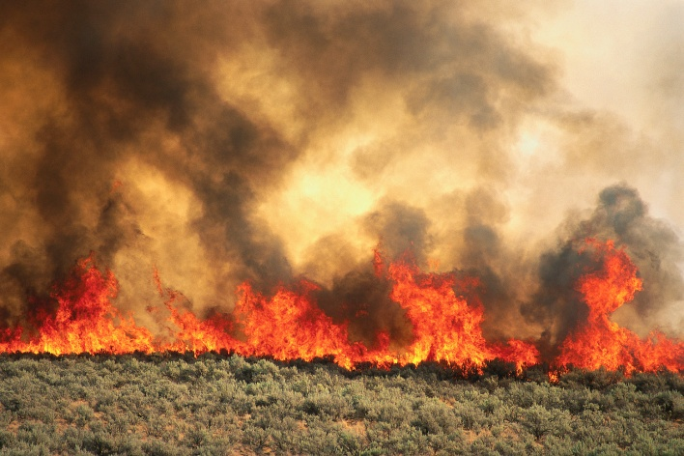
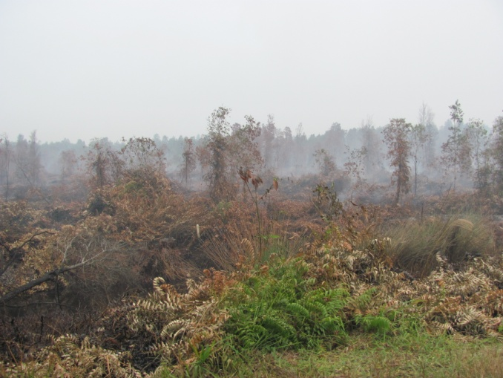
However, all fires are not created equal….

Slide 9
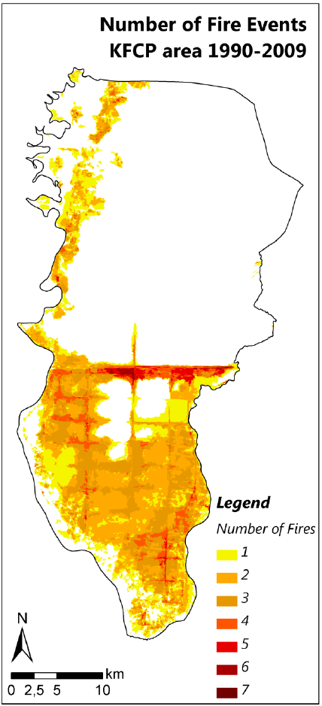
Landsat enables spatial mapping of burned areas and frequency of fires

Slide 10
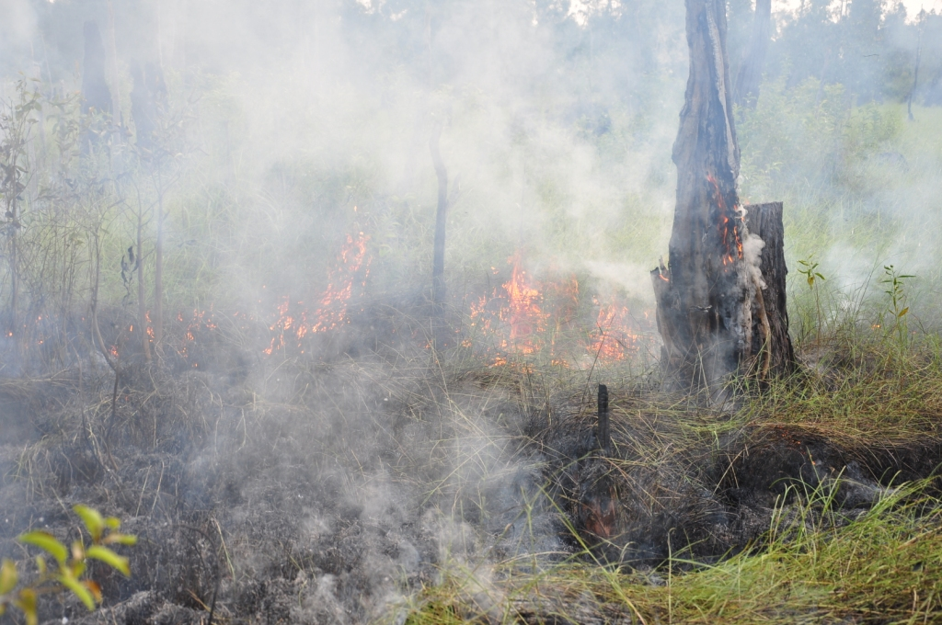
Field activities of the SDSU-IPB Peatland Fires Research Project

Slide 11
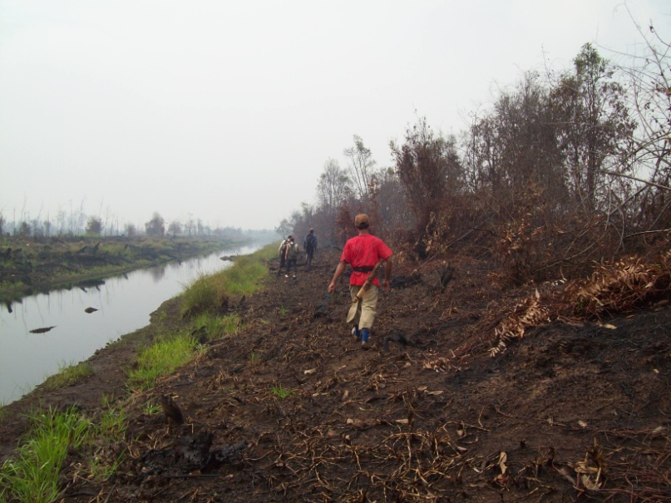
Overview of all the field activities
Ground truthing hotspot data;
Fire scene evaluations - which include:
Fuel availability and consumption
Human actions related to fire causes;
Fire-related peat characteristics;
Peatland smoke characteristics (Year 3);
Hydrology and vegetation monitoring;
Data management;
Socialisation of activities

Slide 12
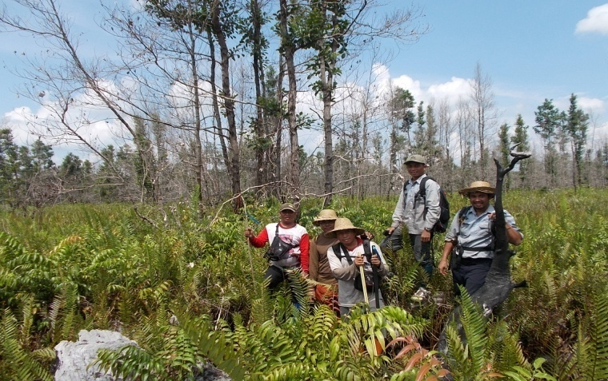
The field team
Dr. Laura Graham – SDSU Project Leader (Palangka Raya)
Sulistyo - Research and Policy Coordinator (Jakarta)
(BOSF Mawas Program and and Admin staff)
Core Monitoring Team (composed of staff each with more than 10 years of experience working in tropical peatlands, in fire, vegetation and hydrology monitoring and conservation)
Ahmad Yunan – Fire Field Supervisor
Andri Thomas – Vegetation and
Peatlands Field Supervisor
Ato – Technical Field Staff (Hydrology)
Didie (Gebeh) – Technical Field Staff
Agus– Technical Field Staff

Slide 13
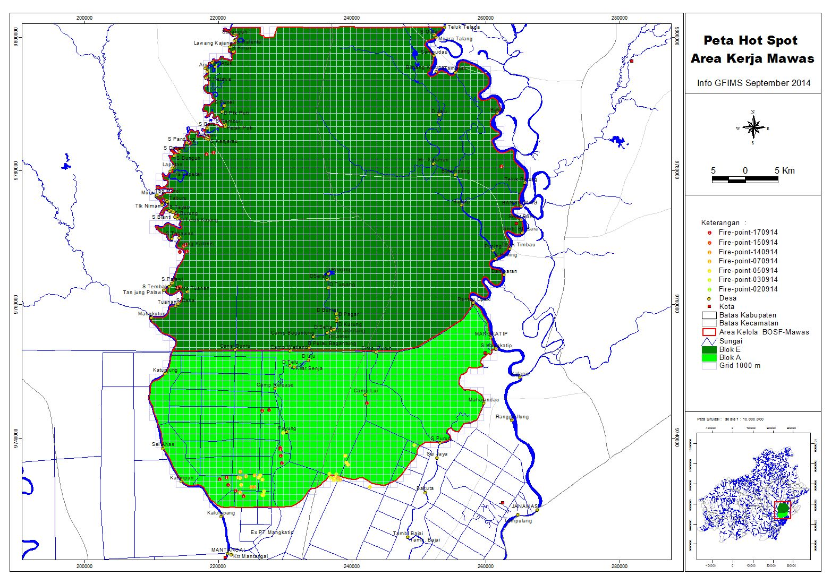
Ground-truthing MODIS hotspots
The field team visits all accessible hotspot locations.
Information from local communities supplements fire detections.
Particular attention is paid to erroneous hotspot detections (‘non-fires’) and fires undetected by MODIS.

Slide 14
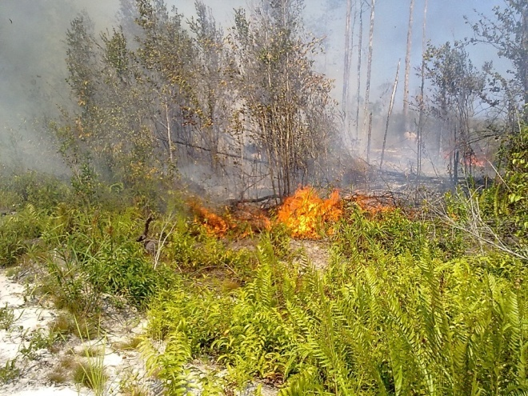
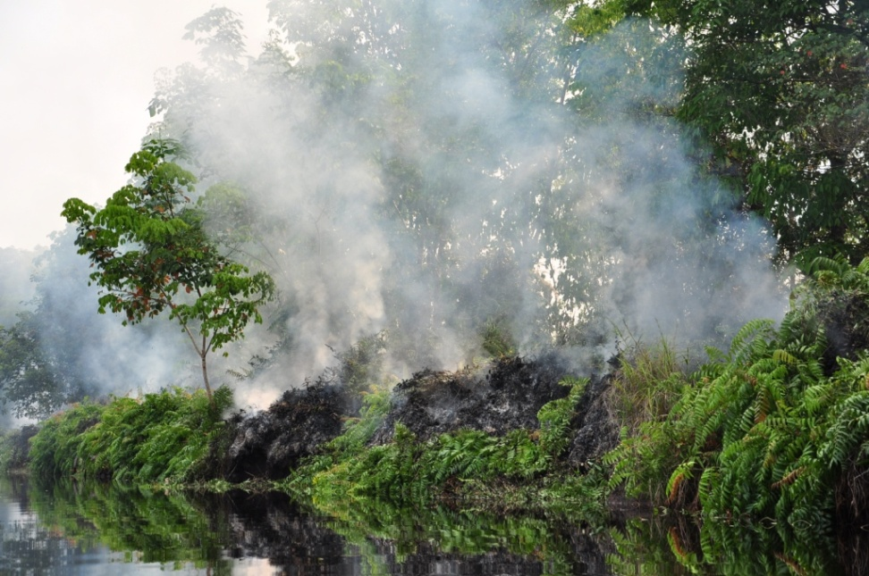
Fire Scene Evaluation
Fire scene data collection includes:
Fire identification (mapping, observation route, timing, ignition point and cause, land tenure).
Weather conditions (wind, humidity, temp.).
Surface fire intensity (burning, scorching, extensive fuel evaluation and fuel loss (fine, medium and large), rate of spread).
Fire damage (area, infrastructure, houses, stock and crops).
Peat fire characteristics (peat fire ignition source, burn depth, rate of spread, water table depth, peat water content samples, peat volume burned).
Human actions related to peat fire occurrences.

Slide 15
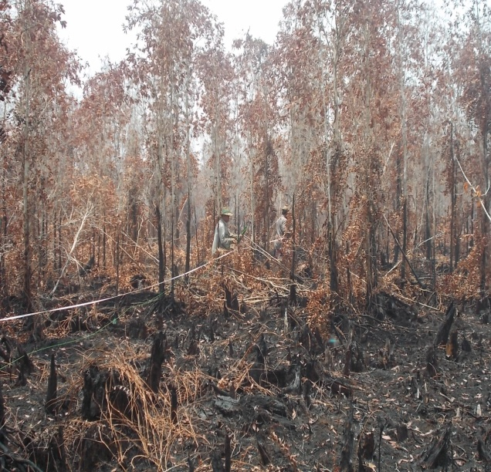
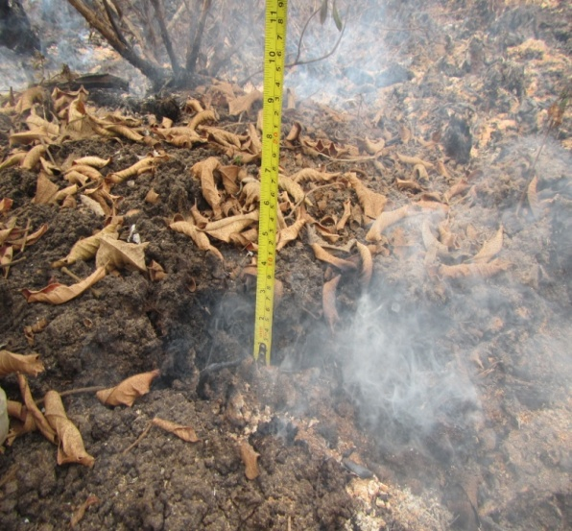
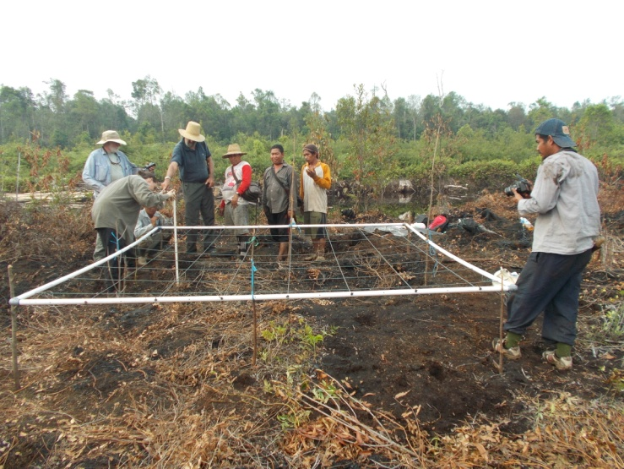
Fire Scene Evaluation – activities to date
The ‘fire’ or ‘smokey season’ began at the end of August 2014.
Three training expeditions with experts from the project have facilitated team training and methodology development.
Multiple data collection activities have taken place since then.

Slide 16
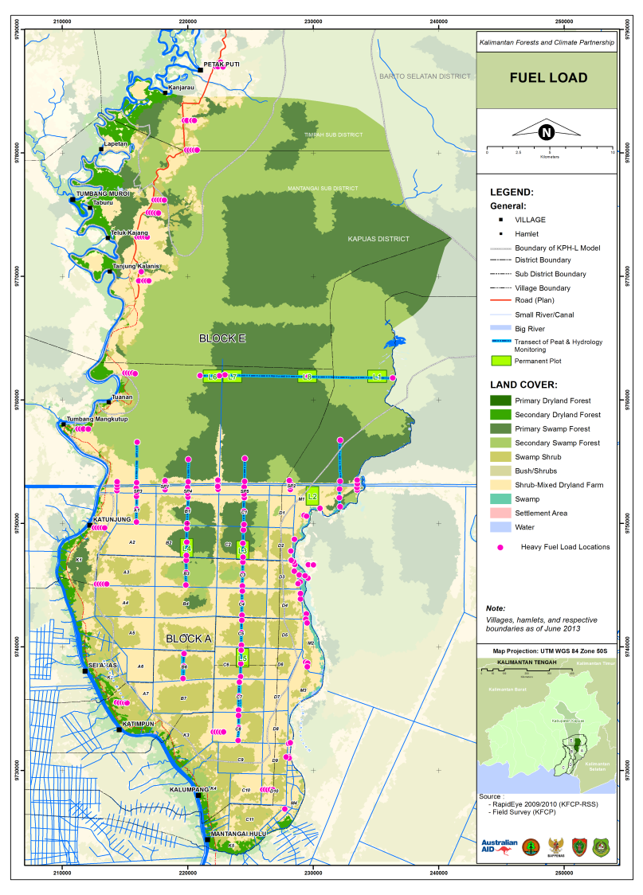
Fuel load, vegetation and hydrology monitoring
The monitoring program includes:
Peak-wet and peak-dry ground water level data collection across 60 km of transects.
Measurement of seedlings, saplings, poles and trees’ height, diameter and species across 96 nested plots across 8 locations.
Re-measurement of heavy fuel loads across 70 ‘fuel-load triangles’ spread across the area.

Slide 17
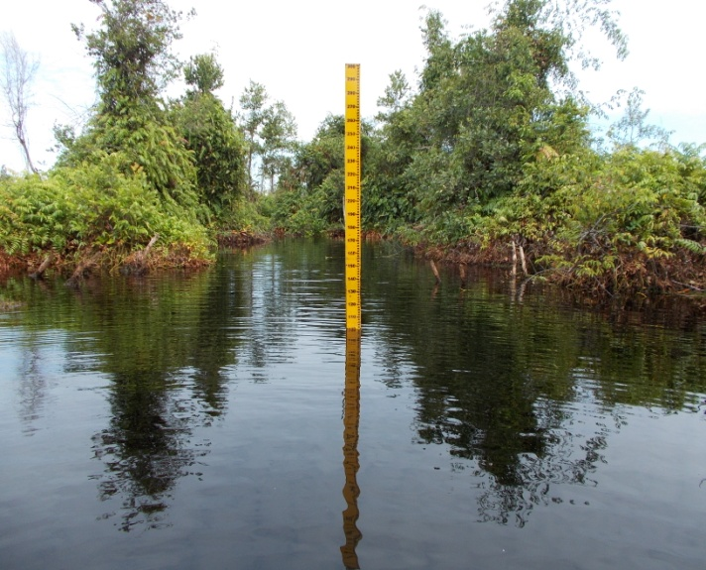
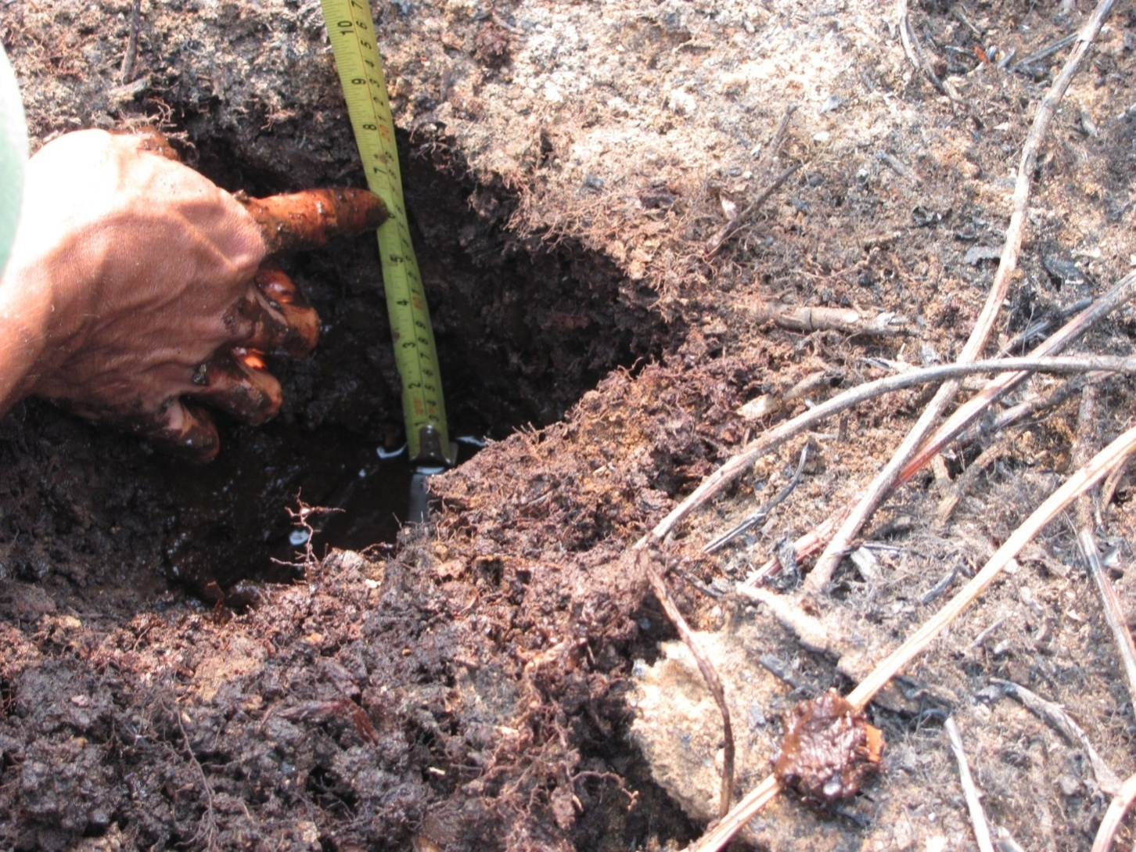
Hydrology monitoring
Two hydrology expeditions have taken place in 2014
Water-table depth is assessed in canals, using dipwells, and at all fire scene investigations.
Water table depth monitoring across the peat dome is critical during the dry season as it is the prime determinant of peat soil susceptibility to burning.

Slide 18
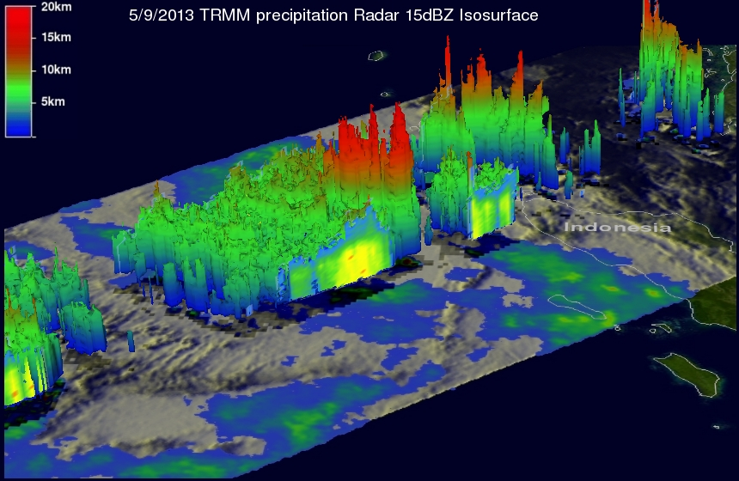
Seasonal Watershed Hydrological Monitoring
Tropical Rainfall Measuring Mission (TRMM) satellite data provides rainfall estimates every 3 hours and for 7-day intervals at a spatial resolution of 5 km.
It is tied to our multiyear regional ground measurements to determine lag times and provide dynamic water table depth estimates.

Slide 19
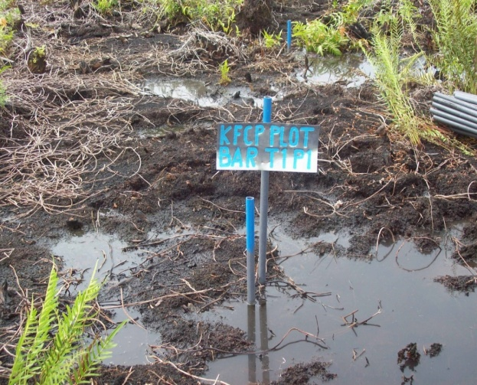
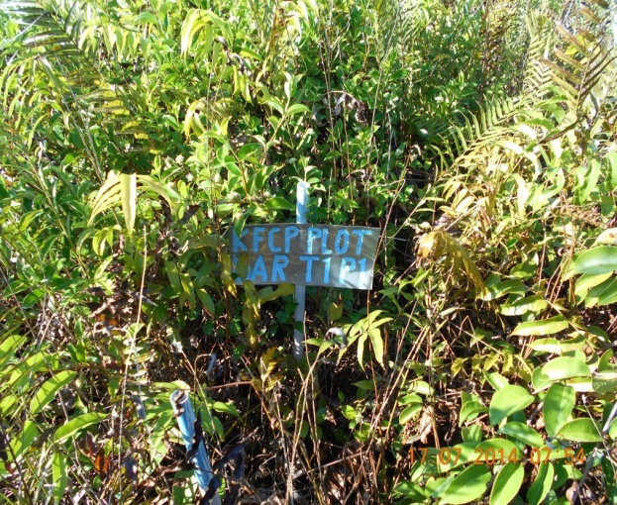
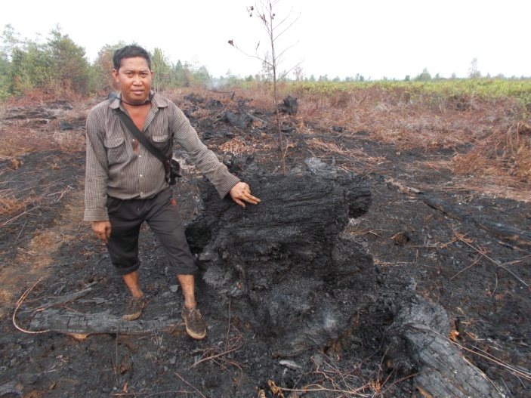
Vegetation monitoring
2010 July 2014 Oct 2014
Vegetation cover is very dynamic with both regrowth and removal.
Plots include primary forests, second growth forests, and shrub/fern dominated areas.
Photos show an area which has burned at least 6 times.

Slide 20
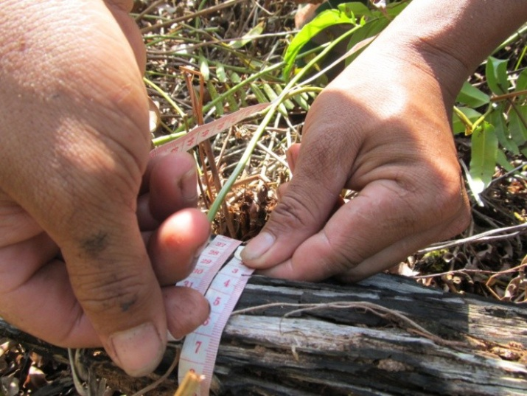
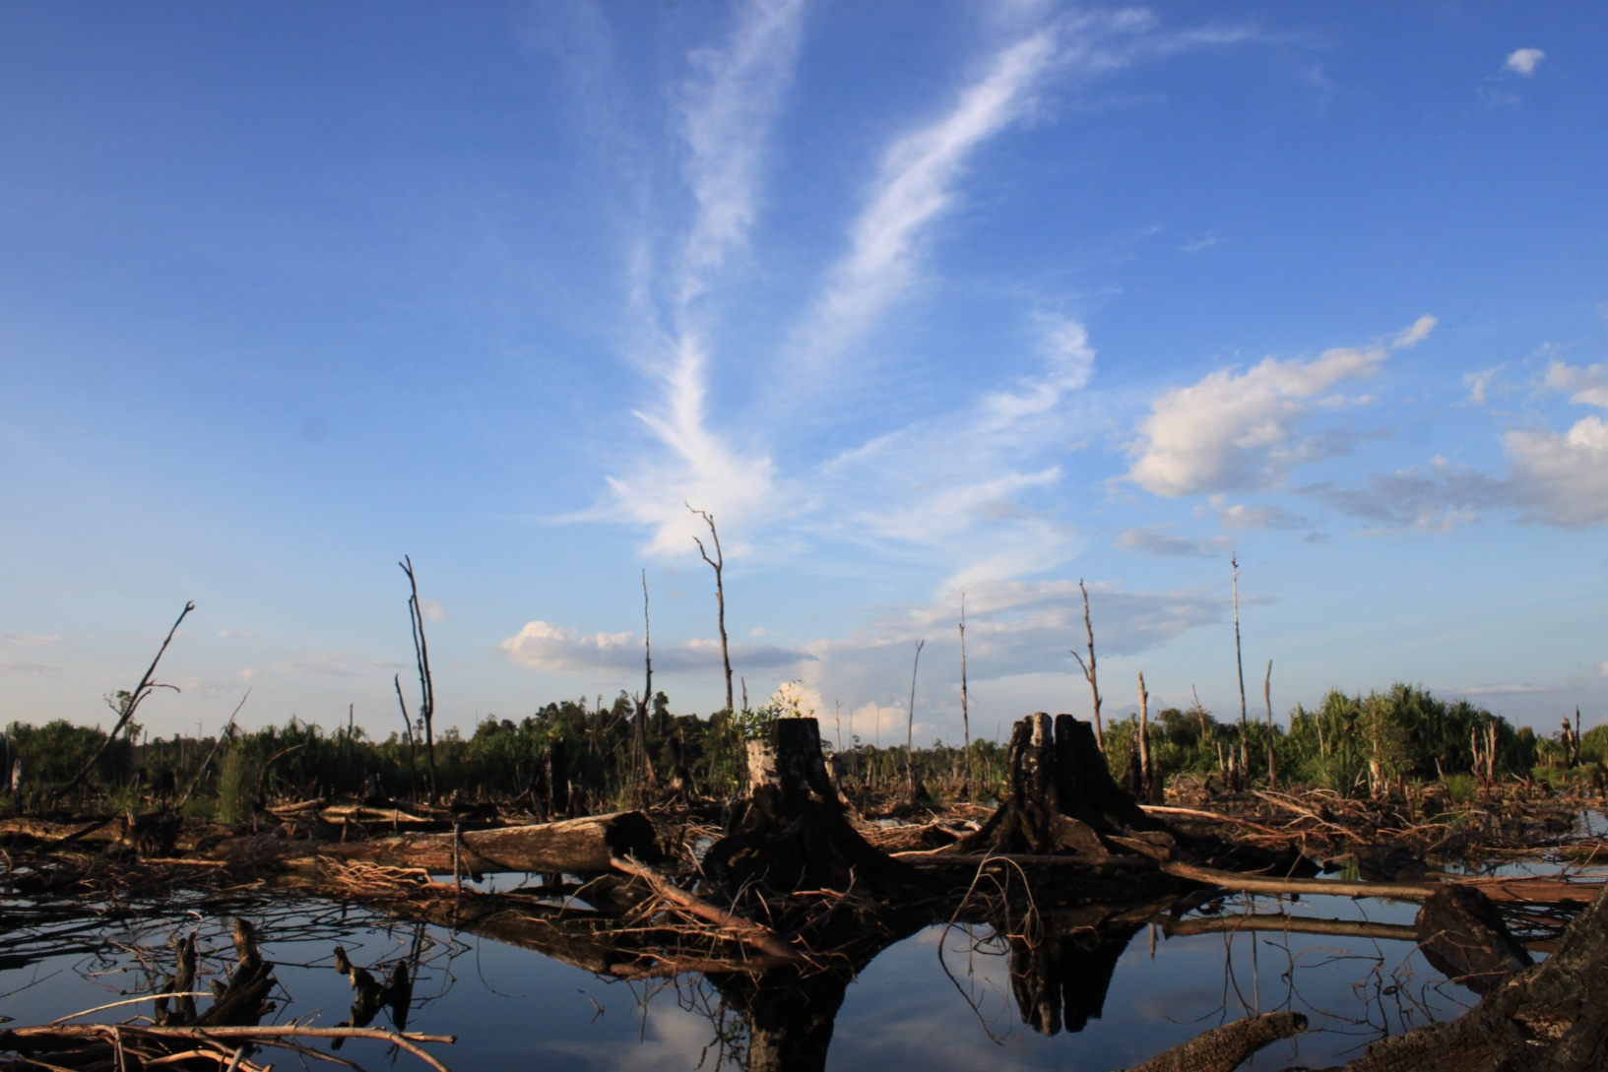
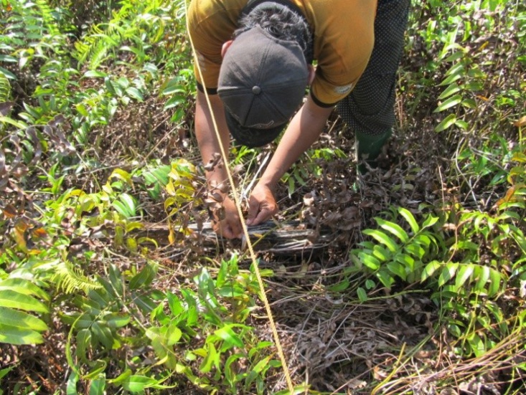
Fuel load monitoring
Fuel load assessments are facilitated with 70 large fuel triangles laid out, across areas of shallow and deep peat, forested to heavily degraded landscapes and far and near to locally land-managed areas.

Slide 21
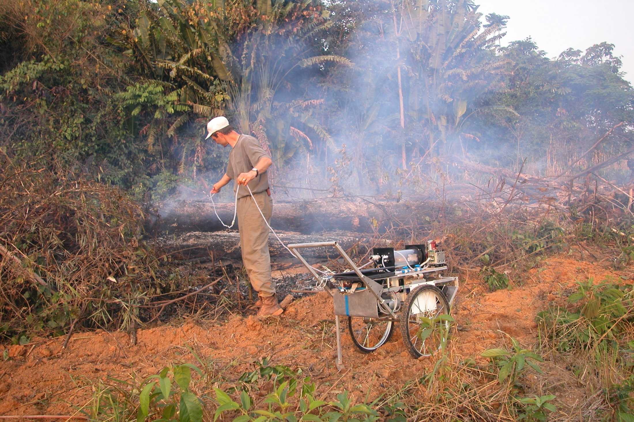
We will also develop relevant emission factors for the Indonesian Peatlands (2015)
~20 Major Gases: HCN, CO, CH4, CO2, NH3, NOx, NMHC, OVOC, HCl, etc
PM2.5 on Filters: EC/OC, metals, tracers, etc

Slide 22
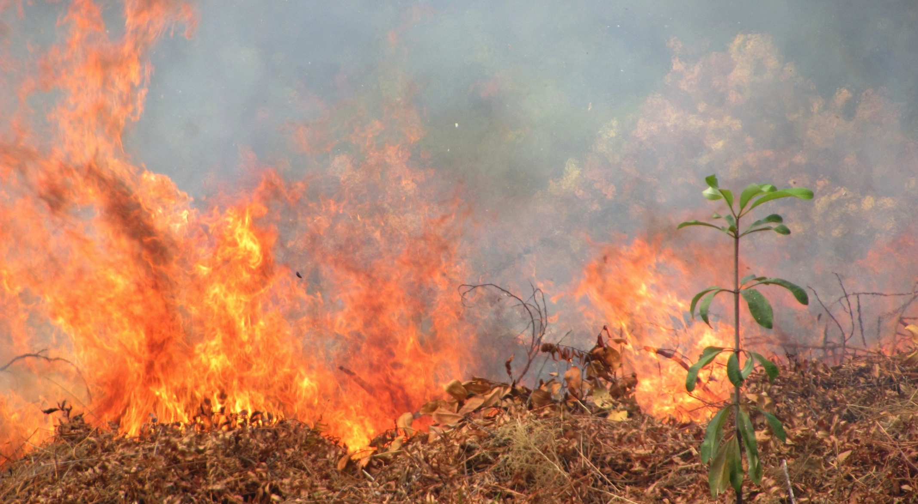
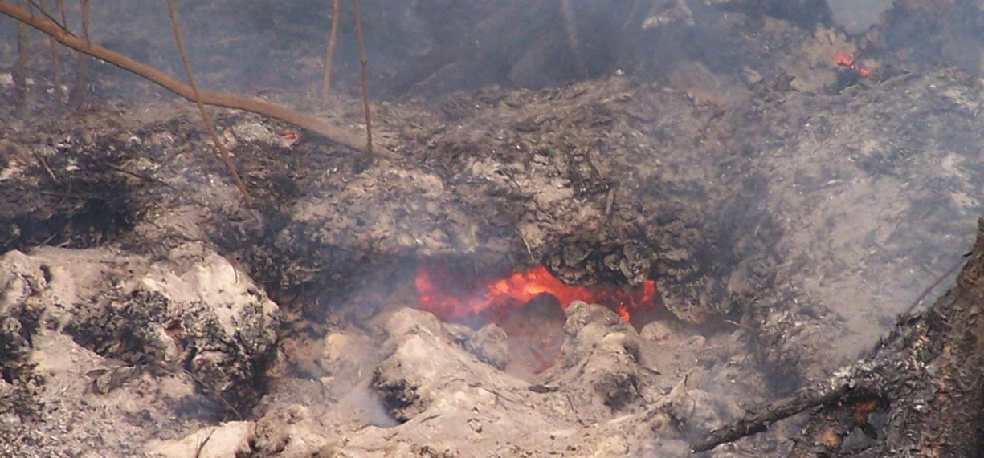
Quantifying burned area and volume
We are mapping the area burned by surface fires and determining the thresholds and risk factors that result in transitions to peat fires (ground fires)

Slide 23
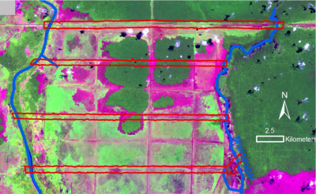
Putting together the pieces
Annual Landsat imagery analyses provide the area and number of times burned.
Landsat imagery also shows landcover types
This provides context for subsequent Lidar analyses

Slide 24
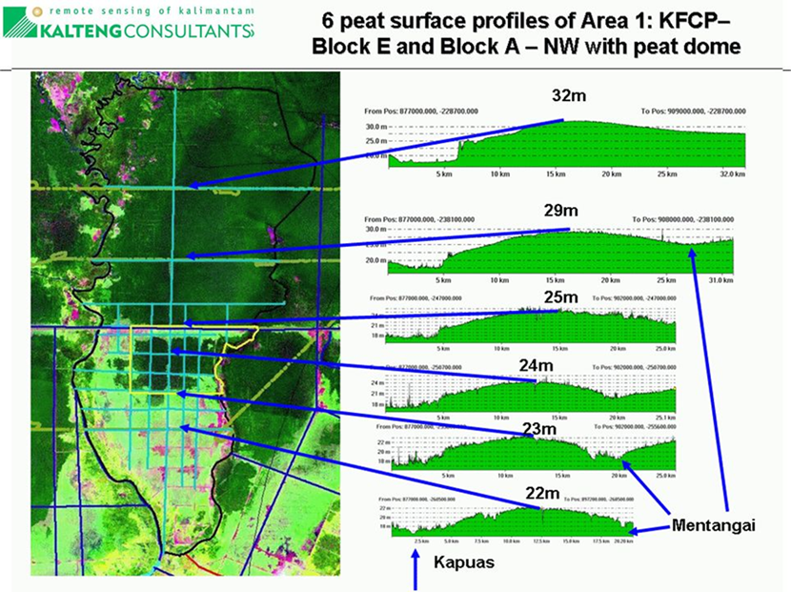
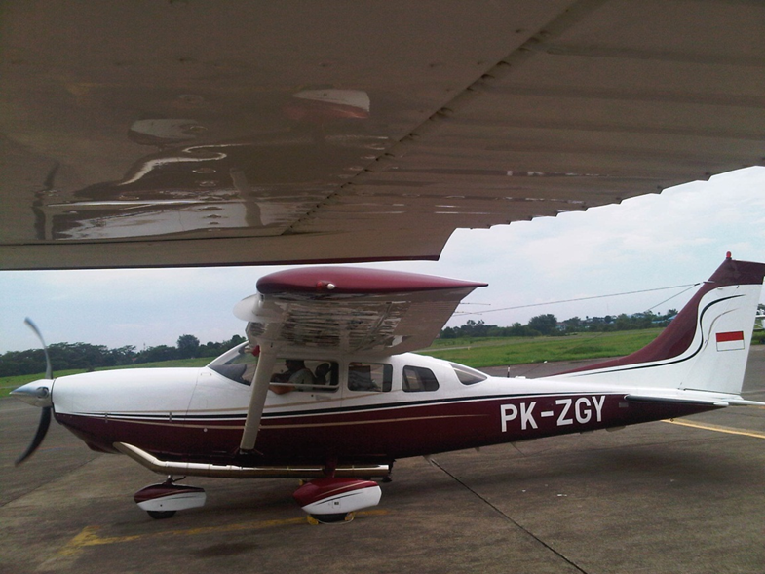
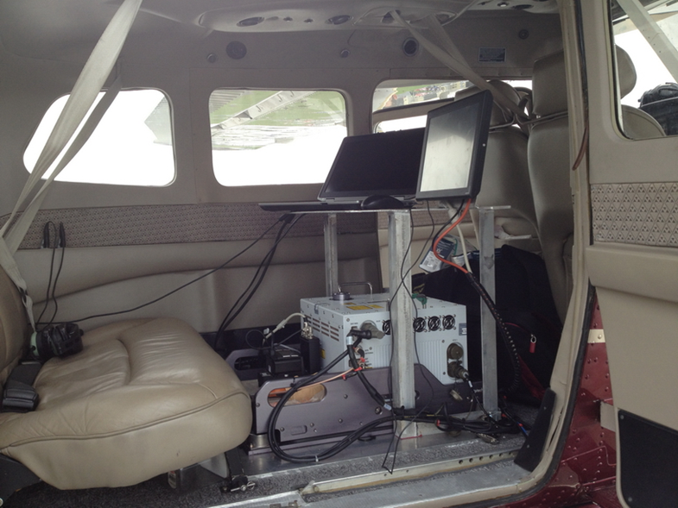
Multiple Lidar Collections
2007
2011
2014

Slide 25
Maps of rivers and drainage canals

Slide 26
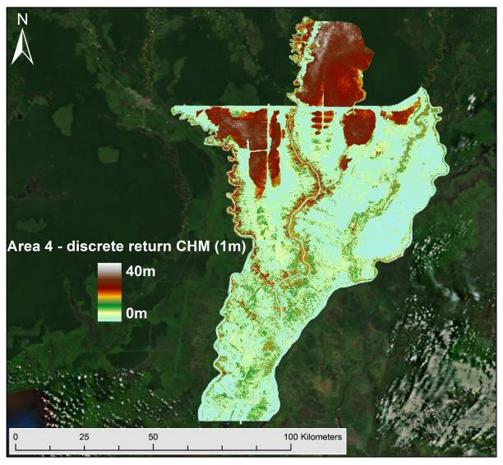
Canopy Height Models

Slide 27
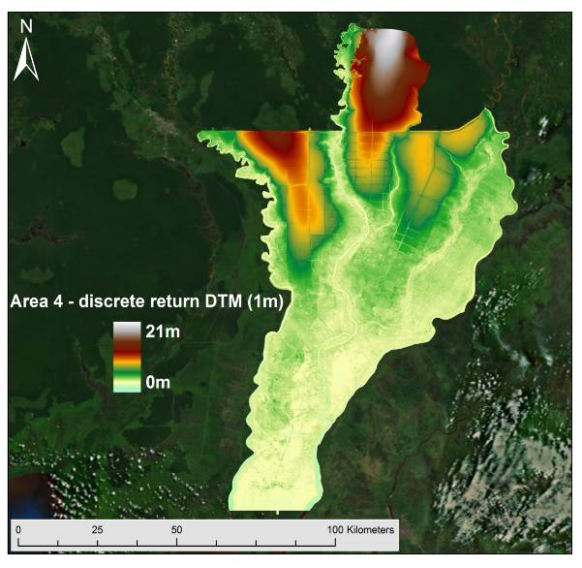
Digital Terrain Maps (1m)

Slide 28
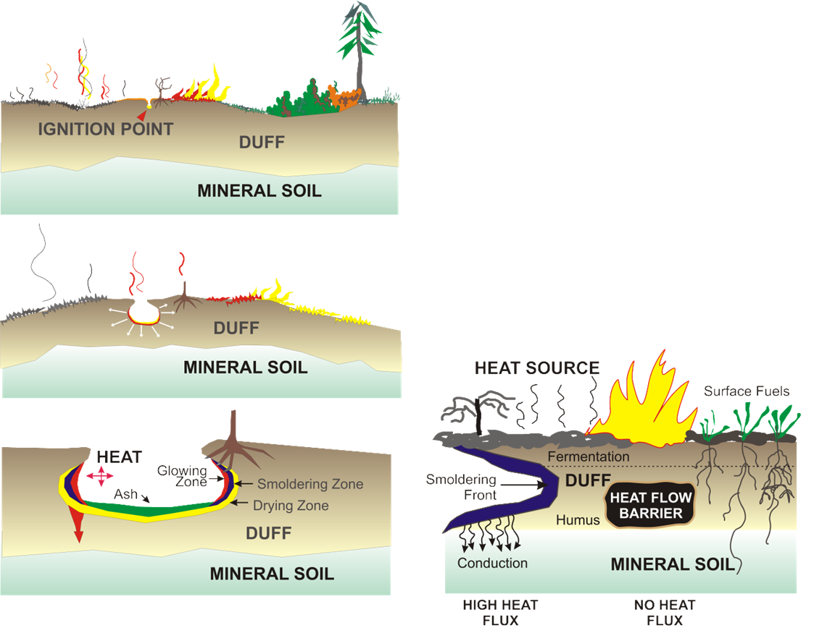
Modeling peat fires is a dynamic process

Slide 29
Questions?

